Slide 1
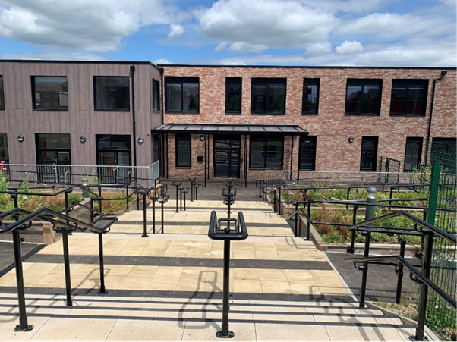


St Cecilia’s
C of E
Primary School
‘Therefore encourage one another,
and build each other up.’​
​
(Thessalonians 5.11)​

Slide 2


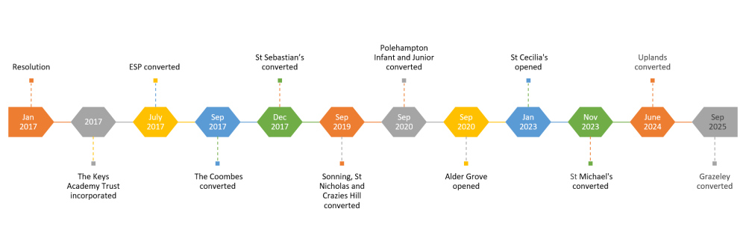
The Keys Academy Trust
One Trust. One Team. Unlocking the future for all.
‘Therefore encourage one another, and build each other up.’ (Thessalonians 5:11)
Perseverance - Forgiveness - Gratitude - Kindness - Truthfulness - Wisdom

Slide 3








Vision and Values
Our values feed into our Key Code
FORGIVENESS GRATITUDE PERSERVERANCE WISDOM TRUTHFULNESS KINDNESS
We have high expectation of behaviour
‘Therefore encourage one another, and build each other up.’ (Thessalonians 5:11)
Perseverance - Forgiveness - Gratitude - Kindness - Truthfulness - Wisdom

Slide 4
School Day
Timings
Nursery
Rec/KS1/KS2
Rec/KS1/KS2
Morning
Afternoon
8:30am
8:35am
3:15pm
Morning Nursery sessions begins
Main school gate opens
Children go into classrooms
Morning task completed
Main school gate opens
Children dismissed from class
11:30am
Morning Nursery sessions ends
8:50am
11:30am
Main school gate closes
School day starts
Class registers taken
Afternoon Nursery sessions begins
Optional: Year 5 and 6
Walking home independently.
Mobile phone handed in to class teacher.
2:30pm*
8:50am – 9:15am
Afternoon Nursery sessions ends
Children marked as late
9:15am
*2:30pm to 3:30pm can be purchased
Register closes
‘Therefore encourage one another, and build each other up.’ (Thessalonians 5:11)
Perseverance - Forgiveness - Gratitude - Kindness - Truthfulness - Wisdom

Slide 5
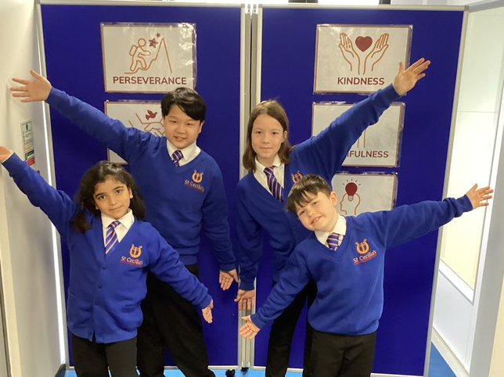
Uniform
Class Uniform – KS1 & 2
Uniform Policy
- St Cecilia's School Sweatshirt / Cardigan
available on our uniform website
- Plain White Shirt
long or short sleeved
- St Cecilia’s School Tie
available on our uniform website
- Black Trousers / Shorts / Skirt
- Black Pinafore Dress
with black socks / tights
- Blue and White Gingham Dress
with white socks
Visit our website to see our uniform policy in more detail, including footwear, jewellery, smart watches, hair, nails and make-up.
- Royal Blue or Black Hair Accessories
not oversized
- Black Shoes
see uniform policy
- Black Socks
- St Cecilia’s School Book Bag or Rucksack
‘Therefore encourage one another, and build each other up.’ (Thessalonians 5:11)
Perseverance - Forgiveness - Gratitude - Kindness - Truthfulness - Wisdom

Slide 6
Uniform
PE Uniform – KS1 & 2
Uniform Policy
- Royal Blue Round Neck T-Shirt
- Black Shorts
no brands visible
- St Cecilia's School Sweatshirt / Cardigan
available on our uniform website
- Trainers
to be active in
Visit our website to see our uniform policy in more detail, including footwear, jewellery, smart watches, hair, nails and make-up.
‘Therefore encourage one another, and build each other up.’ (Thessalonians 5:11)
Perseverance - Forgiveness - Gratitude - Kindness - Truthfulness - Wisdom

Slide 7
Attendance
Attendance matters
Struggling?
We are always happy to support and help if you are struggling with getting your child in. Please address it sooner rather than later.
Illness
A
B
Low Attendance
Attending school is very important and children should be in school every day unless they are too unwell.
The school team will speak with you if attendance becomes low.
Attendance Officer
Nursery
C
D
Attendance is also reviewed regularly by the school’s Attendance Officer as well as Governors and where appropriate the Education Welfare Service will be contacted.
We have the right to remove spaces if there is persistent absence from the setting.
‘Therefore encourage one another, and build each other up.’ (Thessalonians 5:11)
Perseverance - Forgiveness - Gratitude - Kindness - Truthfulness - Wisdom

Slide 8
Collective Worship
We are a Church of England School
A Church of England school is not a faith school.
Rather, it is a school with a designated religious character. Church of England schools exist for the benefit of their local community and are inclusive of people who have a Christian faith, another faith, or no stated religious faith at all.
Monday | Hall | Theme of the Week
Tuesday | Hall | Reflection on Theme of the Week
Wednesday | Hall | Singing and Hymns
Thursday | Hall | Father Sam (St. Paul’s Church)
Friday | Hall | Celebration Assembly
‘Therefore encourage one another, and build each other up.’ (Thessalonians 5:11)
Perseverance - Forgiveness - Gratitude - Kindness - Truthfulness - Wisdom

Slide 9
Snacks
A portion of fresh fruit or vegetables is a healthy snack.
Children must not bring in and items that contain nuts or sesame as we have several children with significant allergies and intolerances in the school. We are not a nut/sesame free school, we are a nut/sesame aware school.
Water Bottles – Children should bring a water bottle in to school each day. These should only contain water and not fruit juices or squash.
Nursery children will have a morning and afternoon break where the school will provide a fruit snack and the option of milk.
Reception, Year 1 and 2 children are entitled to a free fruit snack each morning and free school meals however if parents prefer, they can send their child in with a packed lunch. Reception children will also have the option of milk during the school day.
‘Therefore encourage one another, and build each other up.’ (Thessalonians 5:11)
Perseverance - Forgiveness - Gratitude - Kindness - Truthfulness - Wisdom

Slide 10
Lunch
Packed Lunches
Children can bring in their own packed lunch to school. These packed lunches should be healthy in nature and include items which are high in nutritional value. This could include one dessert. Children will put all their litter from their meal into their packed lunch boxes so that parents can monitor which foods have been eaten. If there are any concerns about the contents of a child’s packed lunch, then parents will be informed.
Hot Lunches
All our school meals are provided by a contracted caterer (Caterlink), who acts in accordance with the School Food Standards. A copy of the weekly menu is on display on the school website, and is sent home, via email, termly. The menu is also available via the School Office if required.
All school lunches are to be ordered the night before at home on Arbor. If children are late and marked in absent then the lunch will automatically cancel.
‘Therefore encourage one another, and build each other up.’ (Thessalonians 5:11)
Perseverance - Forgiveness - Gratitude - Kindness - Truthfulness - Wisdom

Slide 11
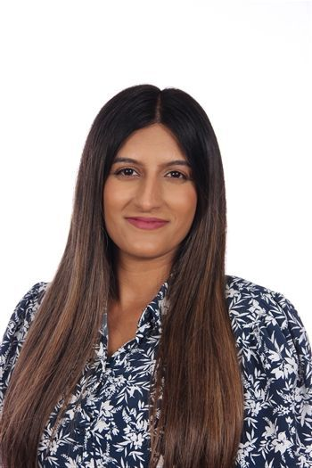
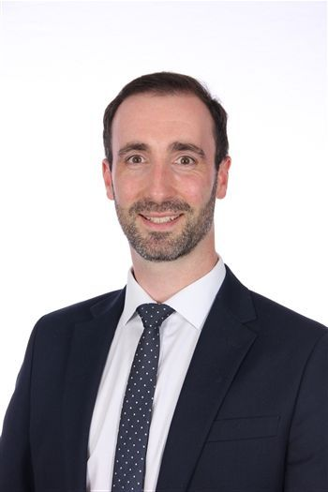
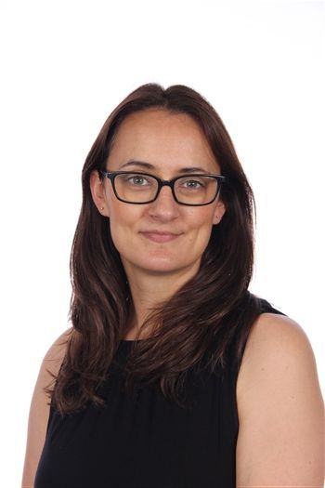
Safeguarding
Safeguarding leaders
Mrs. Gill
Mr. Lappin
Miss. Sharp
‘Therefore encourage one another, and build each other up.’ (Thessalonians 5:11)
Perseverance - Forgiveness - Gratitude - Kindness - Truthfulness - Wisdom

Slide 12
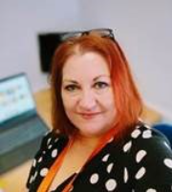
SENDCo
Mrs. Taylor
On the gate in the morning or
sendco@
st-cecilias.wokingham.sch.uk
2 days in school
(Wednesday & Friday)
Limited SEND support resources within the school
SEND resources in agreement by the school through Mrs. Taylor
‘Therefore encourage one another, and build each other up.’ (Thessalonians 5:11)
Perseverance - Forgiveness - Gratitude - Kindness - Truthfulness - Wisdom

Slide 13

Communication
School - Home
Newsletters are sent out every Friday to parents/carers. If you do not have access to an email account, please let the office know and a paper copy will be printed for you.
All dates, important information and class learning is shared in these newsletters.
Text messages and email communications for more urgent information / reminders are sent via our Arbor system.
Parent-teacher meetings happen every term, usually before half term.
‘Therefore encourage one another, and build each other up.’ (Thessalonians 5:11)
Perseverance - Forgiveness - Gratitude - Kindness - Truthfulness - Wisdom

Slide 14
Communication
Whilst we welcome parents to speak to class teachers at the end of the day, please wait until all the children have been released to their parents so you can receive the full attention of the teacher.
Please communicate with all adults in school respectfully.
Teachers will aim to respond to emails within 3 working days.
Emails should be sent via admin.
Safeguarding concerns will be priority.
‘Therefore encourage one another, and build each other up.’ (Thessalonians 5:11)
Perseverance - Forgiveness - Gratitude - Kindness - Truthfulness - Wisdom

Slide 15
Communication
To protect the privacy of everyone in our school community, please avoid naming individual children or teachers in group conversations.
If you have a concern or something you’d like to discuss, please come and talk to us directly so we can help.
Your first point of contact should be either:
📧 Emailing the school office,
💬 Having a chat with your child’s class teacher.
This means we can make sure your concern is listened to and dealt with quickly and appropriately
‘Therefore encourage one another, and build each other up.’ (Thessalonians 5:11)
Perseverance - Forgiveness - Gratitude - Kindness - Truthfulness - Wisdom

Slide 16

Curriculum
‘Therefore encourage one another, and build each other up.’ (Thessalonians 5:11)
Perseverance - Forgiveness - Gratitude - Kindness - Truthfulness - Wisdom

Slide 17
General Information
Medical Lists
If your child has any medical conditions or allergies, please make sure our records (and their medications) are up-to-date. Check this with the office.
Children should not bring in any lip balms, hand gels or hand creams/sprays unless they have been approved by the office.
Other information
Children should bring in their own healthy break time snack and water bottles (water only).
We do not hand out sweets/chocolates at the end of the day for birthdays due to allergies.
‘Therefore encourage one another, and build each other up.’ (Thessalonians 5:11)
Perseverance - Forgiveness - Gratitude - Kindness - Truthfulness - Wisdom

Slide 18

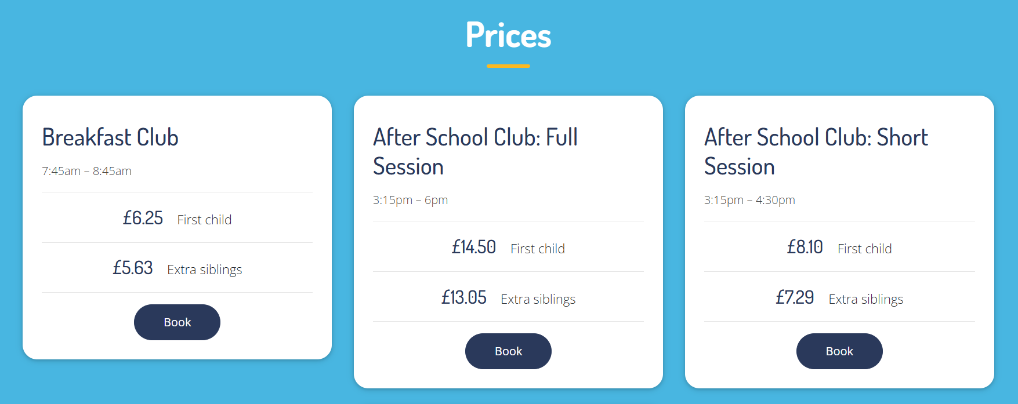
Wraparound Care
Funtastic Kids
‘Therefore encourage one another, and build each other up.’ (Thessalonians 5:11)
Perseverance - Forgiveness - Gratitude - Kindness - Truthfulness - Wisdom

Slide 19

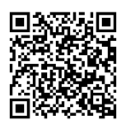


PTA
Parent Teacher Association
WhatsApp Group
‘Therefore encourage one another, and build each other up.’ (Thessalonians 5:11)
Perseverance - Forgiveness - Gratitude - Kindness - Truthfulness - Wisdom

Slide 20
Thank you
for listening
Do you have any questions?

